Slide 1
Data passing between screens

Slide 2
Main content
Public static member
Constructor parameter & Public property
Delegate & event

Slide 3
Public static member

Slide 4
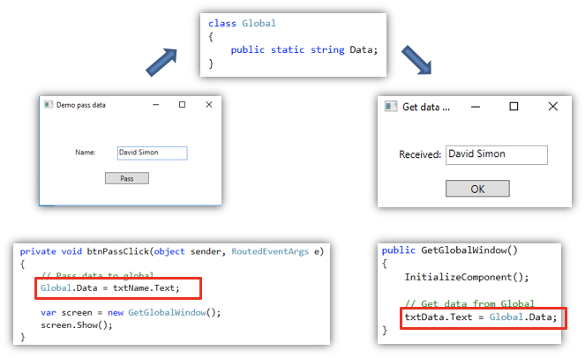
Example

Slide 5
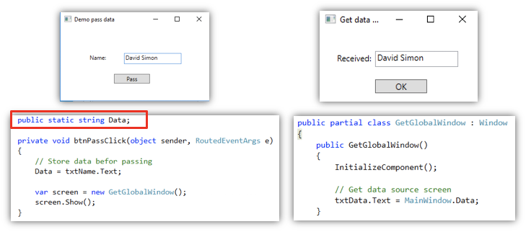
Thêm thành phần tĩnh cho màn hình đích

Slide 6
Constructor’s parameter & public property

Slide 7
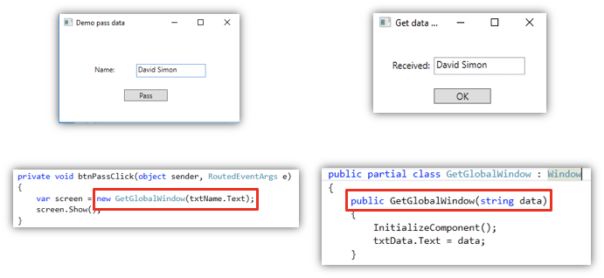
Using constructor to pass data

Slide 8
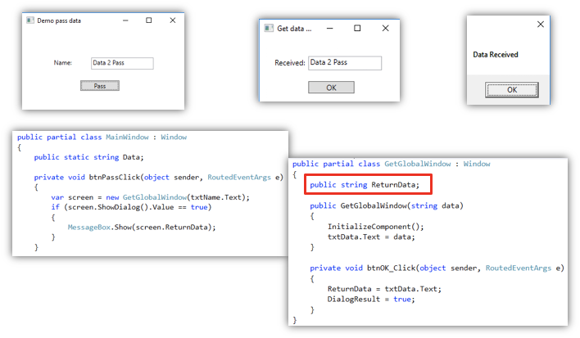
Get data back using public property

Slide 9
Delegate & Event

Slide 10

What is delegate?
Type of function
Can be considered data type

Slide 11
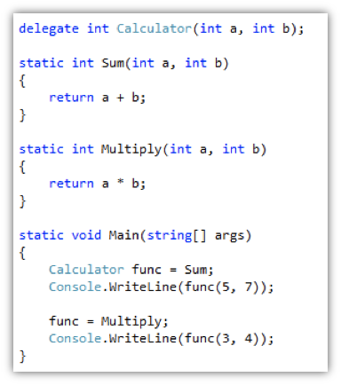
Basic examples

Slide 12
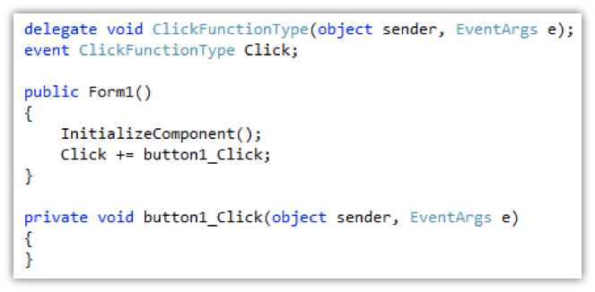
What is event?
Array of pointer functions

Slide 13
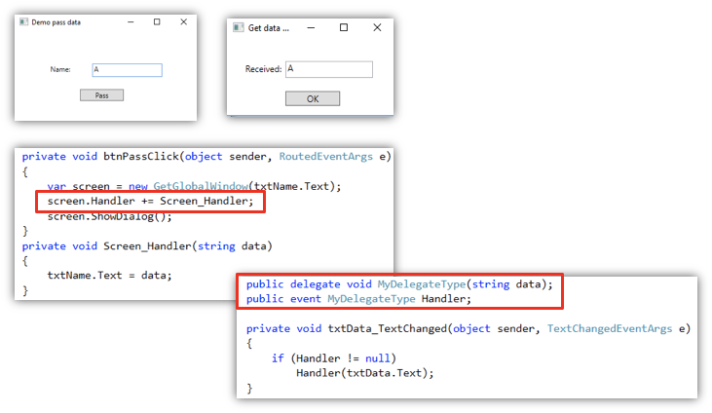
Using delegate & event for receiving data in real time

Slide 14
Exercise
Create a TODO app
There will be a list of tasks that need to be done
Create a button to add a new task from another window
Edit a selected task in another window
Try passing a TodoTask object rather than a string to learn more about reference

